Slide 1

DataBase Connectivity

Slide 2

Objectives
In this session, you will learn to:
Understand SQLite Manager.
Create a Database Table.
Implement Structured Query Language.
Implement Spidering Using a Database.
Understand Basic Models.

Slide 3
SQLite Manager Firefox Add-on
Firefox Add-on call the SQLite Database Manager which is freely available, It can be downloaded using the following link.
The Firefox Browser can be used to create tables, insert data, edit data or run simple SQL queries to retrieve the data from the database.
https://addons.mozilla.org/en-us/firefox/addon/sqlite-manager
Notes:
The database manager is similar to a text editor when working with text files. When you want to do a change in text file , we write a simple Python program just like working with databases.

Slide 4
Creating a Database Table
Databases require well-defined structure.
Create a database table - the name of the table , columns and rows must be clearly specified.
Various data types supported by SQLite are mentioned in the following url: http://www.sqlite.org/datatypes.html
Notes:
Databases require more defined structure than Python lists or dictionaries. When we create a database table we must tell the database in advance the names of each of the columns in the table and the type of data which we are planning to store in each column. When the database software knows the type of data in each column, it can choose the most efficient way to store and lookup the data based on the type of data. Defining structure for your data up front may seem inconvenient at the beginning, but the payoff is fast access to your data even when the database contains a large amount of data.

Slide 5
Creating a Database Table (Contd.)
Below examples shows creation of a database file and a table named “Student” with two columns in the database.
import sqlite3
conn = sqlite3.connect(‘College.sqlite3')
cur = conn.cursor()
cur.execute('DROP TABLE IF EXISTS Student')
cur.execute('CREATE TABLE Student (StudentID INTEGER, StudentName TEXT)')
conn.close()
Notes:
The connect operation makes a “connection” to the database stored in the file College.sqlite3 in the current directory. If the file does not exist, it will be created.
The reason this is called a “connection” is that sometimes the database is stored on a separate “database server” from the server on which we are running our application. In our simple examples the database will just be a local file in the same directory as the Python code we are running.

Slide 6
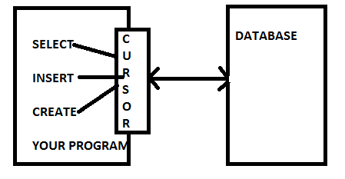
Cursor
Cursor is used to perform various operations on the data stored in the database programmatically.
Cursor executes commands on the contents of the database using execute() method.
Notes:
A cursor is like a file handle that we can use to perform operations on the data stored in the database. Calling cursor() is very similar conceptually to calling
open() when dealing with text files. Once we have the cursor, we can begin to execute commands on the contents of the database using the execute() method.

Slide 7
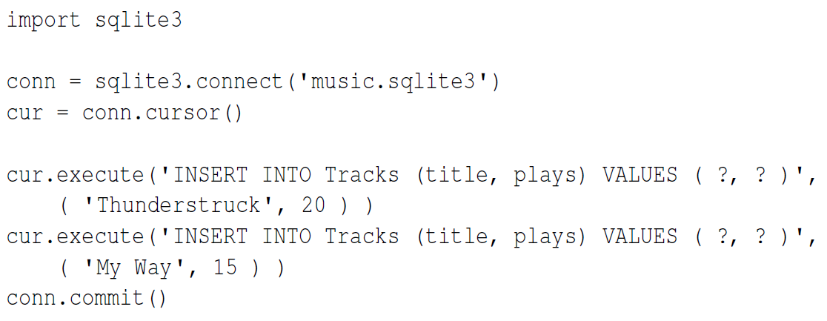
Cursor (Contd.)
Tracks:
(u'Thunderstruck', 20)
(u'My Way', 15)
Notes:
First we INSERT two rows into our table and use commit() to force the data to be written to the database file.

Slide 8
Structured Query Language (SQL) Summary
Basic SQL Operations
Create Table
CREATE TABLE Tracks (title TEXT, plays INTEGER)
Insert Records into a Table
INSERT INTO Tracks (title, plays) VALUES ('My Way', 15)
Filtering Records into a Table
SELECT * FROM Tracks WHERE title = 'My Way'
Ordering Records
SELECT title,plays FROM Tracks ORDER BY title
Deleting Records from a Table
DELETE FROM Tracks WHERE title = 'My Way'
Updating Records from a Table
UPDATE Tracks SET plays = 16 WHERE title = 'My Way'
Notes:
A relational database is made up of tables, rows, and columns. The columns generally have a type such as text, numeric, or date data. When we create a table, we indicate the names and types of the columns: CREATE TABLE Tracks (title TEXT, plays INTEGER).
To insert a row into a table, we use the SQL INSERT command:
INSERT INTO Tracks (title, plays) VALUES ('My Way', 15)
The INSERT statement specifies the table name, and then a list of the fields/columns that you would like to set in the new row, and then the keyword VALUES and then a list of corresponding values for each of the fields. The SQL SELECT command is used to retrieve rows and columns from a database. The SELECT statement lets you specify which columns you would like to retrieve as well as a WHERE clause to select which rows you would like to see. It also allows an optional ORDER BY clause to control the sorting of the returned rows.
SELECT * FROM Tracks WHERE title = 'My Way'
Using * indicates that you want the database to return all of the columns for each row that matches the WHERE clause.
Note, unlike in Python, in a SQL WHERE clause we use a single equal sign to indicate a test for equality rather than a double equal sign. Other logical operations
allowed in a WHERE clause include <, >, <=, >=, !=, as well as AND and OR and parentheses to build your logical expressions.
You can request that the returned rows be sorted by one of the fields as follows: SELECT title,plays FROM Tracks ORDER BY title
To remove a row, you need a WHERE clause on an SQL DELETE statement. The WHERE clause determines which rows are to be deleted:
DELETE FROM Tracks WHERE title = 'My Way'
It is possible to UPDATE a column or columns within one or more rows in a table using the SQL UPDATE statement as follows:
UPDATE Tracks SET plays = 16 WHERE title = 'My Way'
The UPDATE statement specifies a table and then a list of fields and values to change after the SET keyword and then an optional WHERE clause to select the rows that are to be updated. A single UPDATE statement will change all of the rows that match the WHERE clause, or if a WHERE clause is not specified, it performs the UPDATE on
all of the rows in the table.
These four basic SQL commands (INSERT, SELECT, UPDATE, and DELETE) allow the four basic operations needed to create and maintain data.

Slide 9
Spidering Using a Database
A program which automatically fetch the content from Web pages. Spiders are used to feed pages to Search Engines.
It's called a Spider because it crawls over the Web. It is also called as Web Crawler.
Because most web pages contain links to other pages a Spider can start from anywhere. As soon as it finds a link to another page it goes off and fetches it.
A large web Search Engine will have many Spiders.

Slide 10
Basic Data Modeling
Data Modeling
Data Modeling is a process of breaking the application data into multiple Tables and creating the relationship among the Tables.
Data Modeling Provides Design document that represents the Tables and their relationships.
In Data Modeling Redundancy of data can be identified and data can be Normalized.
Multiple Tables are linked by using Primary Key and Foreign Key.
CREATE TABLE People (id INTEGER PRIMARY KEY, name TEXT UNIQUE, retrieved INTEGER)
Notes:
The real power of a relational database is when we make multiple tables and make links between those tables. The act of deciding how to break up your application
data into multiple tables and establishing the relationships between the two tables is called data modeling. The design document that shows the tables and their
relationships is called a data model.
This duplication of string data violates the best practices for database normalization which basically states that we should never put the same string data in the
database more than once. If we need the data more than once, we create a numeric key for the data and reference the actual data using this key.
We can create the People table with this additional id column as follows:
CREATE TABLE People (id INTEGER PRIMARY KEY, name TEXT UNIQUE, retrieved INTEGER)
Notice that we are no longer maintaining a friend count in each row of the People table. When we select INTEGER PRIMARY KEY as the type of our id column,
we are indicating that we would like SQLite to manage this column and assign a unique numeric key to each row we insert automatically. We also add the keyword
UNIQUE to indicate that we will not allow SQLite to insert two rows with the same value for name.

Slide 11

Just a Minute
__________command is used to view records in a table.

Slide 12
Just a Minute
__________command is used to view records in a table.
Answer:
Select
Notes:
Solution:
Select

Slide 13
Just a Minute
________ object is used to fetch records from a database table.

Slide 14
Just a Minute
________ object is used to fetch records from a database table
Answer:
Cursor
Notes:
Solution
Cursor

Slide 15
Just a Minute
The act of deciding how to break up your application
data into multiple tables and establishing the relationships between the two tables is called _____

Slide 16
Just a Minute
The act of deciding how to break up your application
data into multiple tables and establishing the relationships between the two tables is called _____
Answer:
Data Modelling
Notes:
Solution:
DataModel

Slide 17
Activity
Activity : Implementing Database Operation
Problem Statement:
Write a program to connect to Database stored in file music.sqlite3 of the current directory. If the file does not exist, it should be created. Create a table called writers with following structure:
1. Create a table called writers with following structure:
2. Insert following records:
1,'Jack London'
2,'Honore de Balzac'
3,'Lion Feuchtwanger'
4,'Emile Zola'
5,'Truman Capote'
3. Then retrieve first 4 records from Table.
4. Update the record whose id is 4.
Writers
Column Name | Data Type | Constraints
Id | Number | Primary Key
Name | Varchar (25)
Notes:
Solution:
In order to do this activity, you need to perform the following tasks:
Create a Python empty project.
Use sqlite3 library to access python database API, use connect() to create and open the connection, use execute() to execute SQL create table statement, use execute() to write SQL insert statement to Insert two records, use close() to close the connection.
Task 1: Create a Python empty project:
Step 1: Open NetBeans 8.0.2.
Step 2: Click File menu.
Step 3: Select New Project.
Step 4: Select Python from Categories list and Python Project from Projects list.
Step 5: Click Next button.
Step 6: On New Python Project dialog box set the Project Name as CR_Session17_Activity01.
Step 7: Select project Location by clicking Browse button.
Step 8: Click Finish button.
Task 2: Use sqlite3 library to access python database API, use connect() to create and open the connection, use execute() to execute SQL create table statement, use execute() to write SQL insert statement to Insert two records, use close() to close the connection:
Step 1: Type the following code:
import sqlite3
conn = sqlite3.connect('music.sqlite3')
cur = conn.cursor()
cur.execute('DROP TABLE IF EXISTS Writers')
cur.execute('CREATE TABLE Writers(Id number PRIMARY KEY ,Name VARCHAR(25))')
cur.execute("INSERT INTO Writers VALUES(1,'Jack London')")
cur.execute("INSERT INTO Writers VALUES(2,'Honore de Balzac')")
cur.execute("INSERT INTO Writers VALUES(3,'Lion Feuchtwanger')")
cur.execute("INSERT INTO Writers VALUES(4,'Emile Zola')")
cur.execute("INSERT INTO Writers VALUES(5,'Truman Capote')")
conn.commit()
print 'Writers:'
cur.execute('SELECT * FROM Writers LIMIT 4')
rows = cur.fetchall()
for row in rows:
print row[0], row[1]
cur.execute("UPDATE Writers SET Name = 'Guy de Maupasant' WHERE Id = 4")
print("Number of rows updated:"+ str(cur.rowcount))
conn.commit()
cur.close()
Step 2: Run the program.

Slide 18
Summary
In this session, you learned:
A Cursor is like a File Handle that can be used to perform operations on the data stored in the database.
The Database Manager is similar to a text editor when working with text files.
A Relational Database is made up of tables, rows and columns. The columns generally have a type such as text, numeric or date.
The act of deciding how to break up your application data into multiple tables and establishing the relationships between the two tables is called Data Modeling.

